Slide 1
Day 3
Classification Models

Slide 2
Before the Course
Upon completion of this course, you will have acquired general knowledge of introductory artificial intelligence algorithms and data analysis.
Since the specific topics are difficult to understand and it will not be easy for the person to settle the logic during the lesson, a lot of individual practice is required.
Slides will be explained with images rather than text. That is why it is extremely important to take notes during the lesson.
Since the titles are sufficient for basic level algorithms, the titles should be researched, and research should be done on sites that contain plenty of practice and theoretical information.

Slide 3

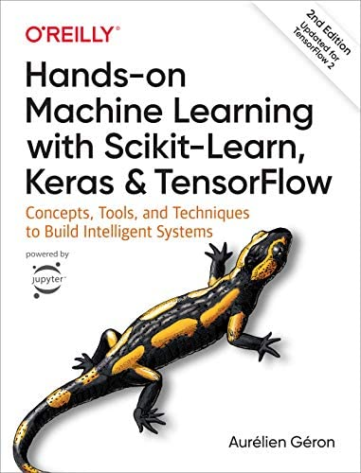
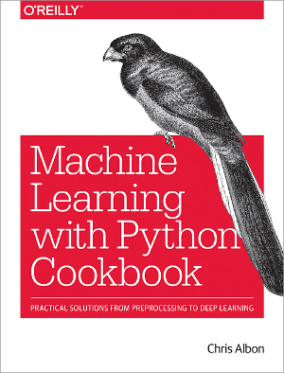
Source
Deep Learning Türkiye
Hands-on Machine Learning with Scikit-Learn, Keras & TensorFlow
Aurelien Geron
Machine Learning with Python Cookbook
Chris Albon

Slide 4
Ömer Cengiz
Twitter: omerr.cengizz
LinkedIn: omercengiz96
GitHub: omercengiz

Slide 5
What Will You Learn In This Course
What is Classification?
How to classify with Logistic Regression?
What is the Activation Function?
Why do we use the Activation Function?
How do we measure the performance of our Classification Model?
Cross Validation
Accuracy, Confusion Matrix
What is the use and importance of Classification Threshold?
What is the place of ROC and AUC in performance measurement?
What is KNN(K-Nearest Neighbors), SVM(Support Vector Machine) and Decision Trees ?

Slide 6

What Will We Learn Today?

Slide 7
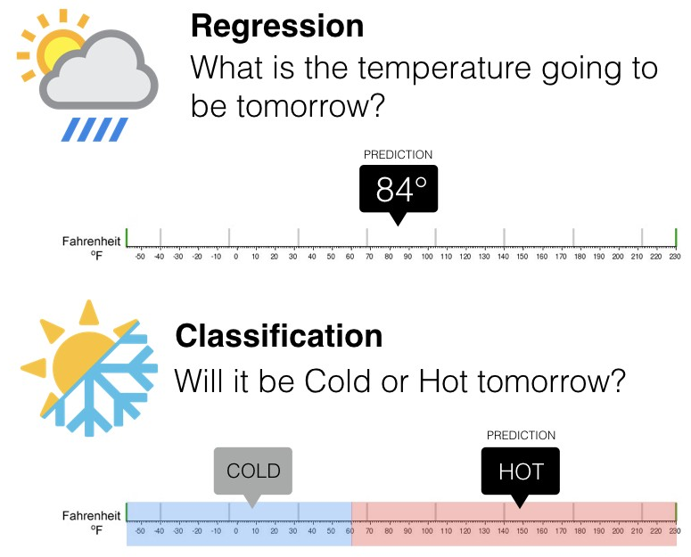
What is Classification?
It is a supervised learning algorithm where input data can be easily categorized, tagging data and classifying them. There can be binary classifiers with only two outcomes, or multiclass classifiers with more than two.
It can be performed on both structured and unstructured data, as it is the process of classifying a particular dataset. The process begins with estimating the class of given data points. Classes are often called targets, tags, or categories.

Slide 8
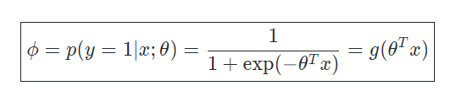
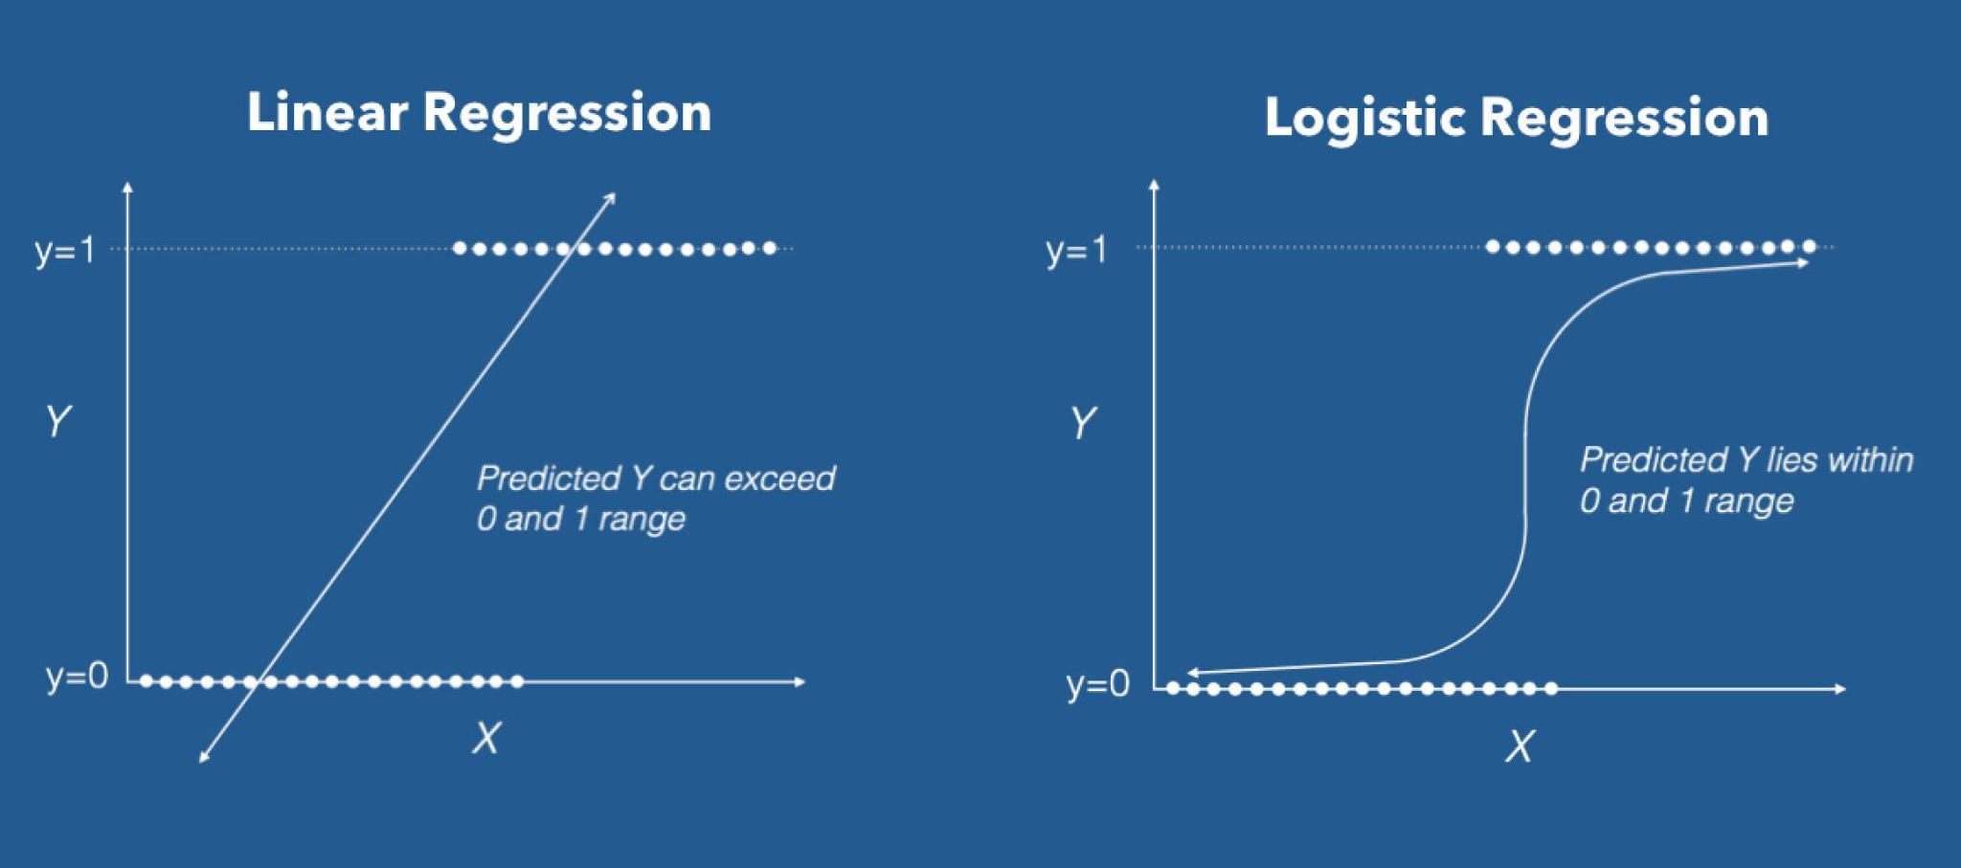
Logistic Regression
Logistic regression is a regression method that performs classification in which the dependent variable is a categorical variable. The aim is to establish a linear model between dependent and independent variables. It works if the dependent variable can take 2 different values. Logistic regression produces a specific probability value between 0 and 1, rather than predicting exactly 0 or 1.

Slide 9
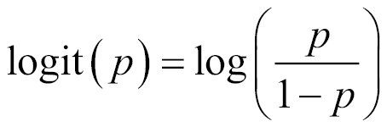
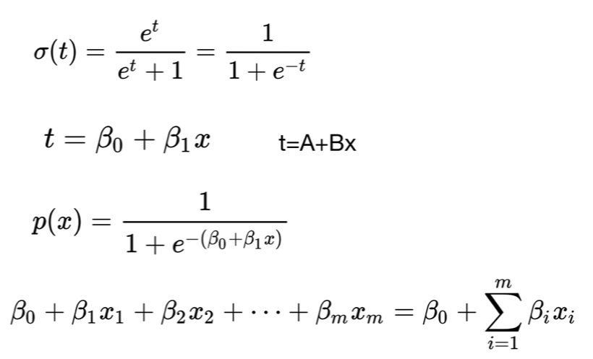
Logistic Regression
It is a basic classification technique
It takes its name from the logit transformation we apply to the dependent variable, also known as "Logit Regression"
It belongs to the group of linear classifiers
Similar to Linear and Polynomial Regression
It is a fast algorithm and not complicated
Mainly used for binary classification

Slide 10
Activation Function

Slide 11
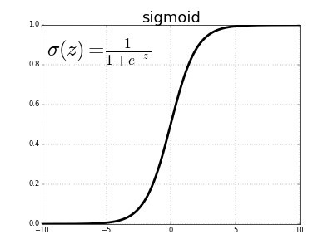
Sigmoid Function
It is a nonlinear function. The value range of this function, which has a probabilistic approach to decision making, is between [0,1].
Changes in the x value in these functions will cause serious changes on the y value. No matter how much x changes between (-infinity, +infinity) the activation value will always be between 0 and 1

Slide 12
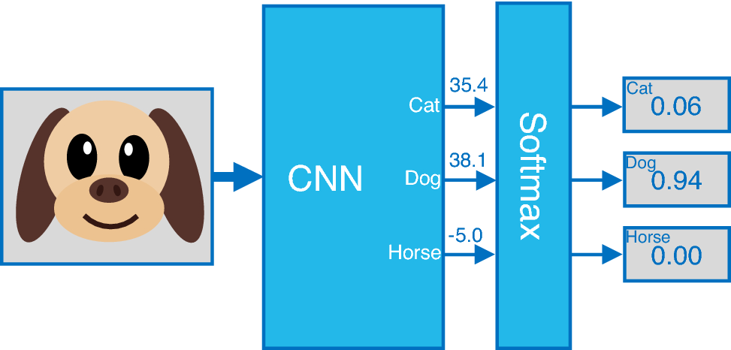

What to Do When There Are More Than Two Classes
Softmax
Its structure is very similar to the Sigmoid function.
It performs well as it has a classifier structure like Sigmoid.
The most important difference here is that unlike the sigmoid function, it is used for a multi-class problem.
It is preferred especially for the output layer in Deep Learning models.

Slide 13
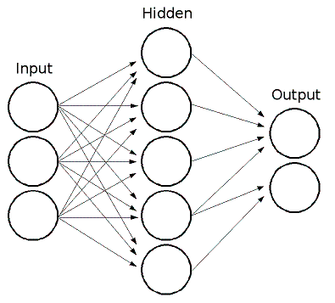
Why Do We Use the Activation Function?
Why do Neural Networks need Activation Functions?
The process we do in a neural network;
Multiplying the inputs we receive by the weight vector
Adding the bias value to the result
Then apply the Activation function

Slide 14
Measuring the Performance of the Classification Model

Slide 15
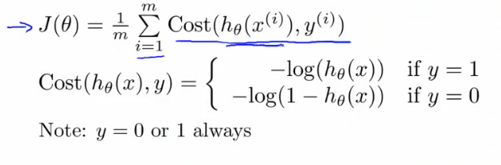
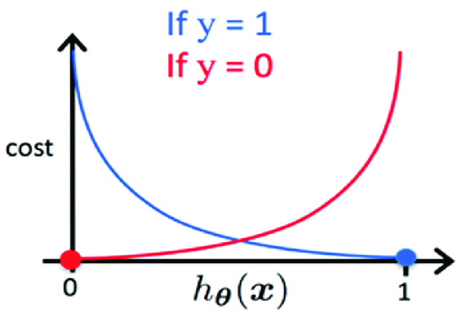
Cost Function
It's a measure of error between the value your model predicts and what the value actually is. After training your model, you should see how well your model performs. While accuracy can tell you how well the model is performing, they don't give you an idea of how you can improve them better. That's why you need a cost function that can help you calculate when the model is most accurate, as you have to get to that little point between an under-trained model and an over-trained model.

Slide 16
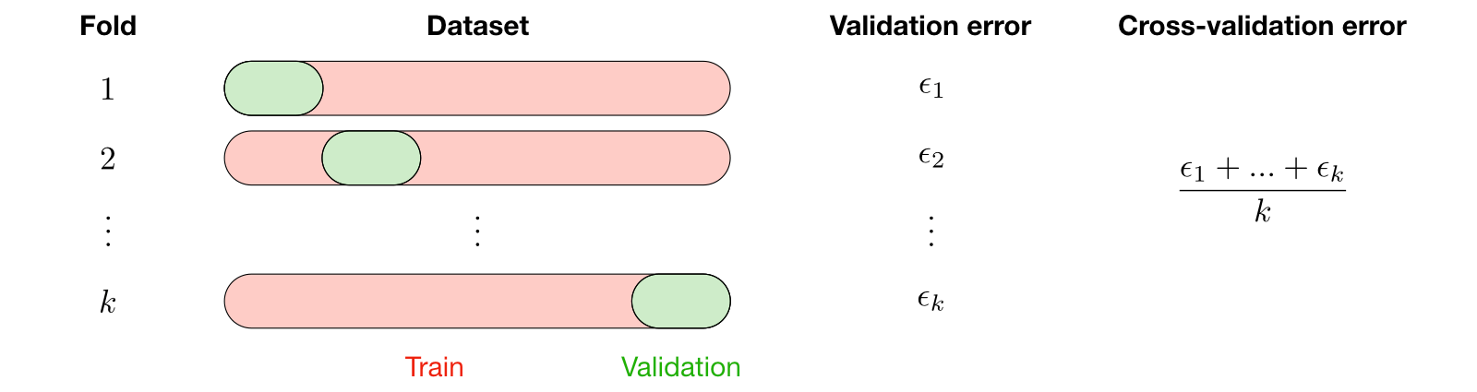
Cross Validation
Cross validation, also called CV, is a method used to select a model that does not rely heavily on the initial training set.

Slide 17
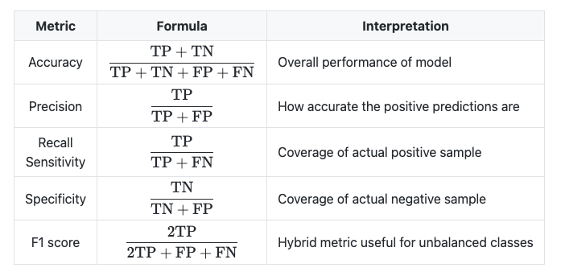
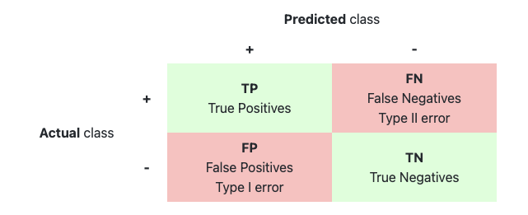
Accuracy
It is a measure for evaluating classification models. Accuracy is the proportion of predictions our model makes correctly. In other words, it is the ratio of Total Correctly Predicted values to all predictions. It is not sufficient on its own, especially for unevenly distributed datasets.

Slide 18
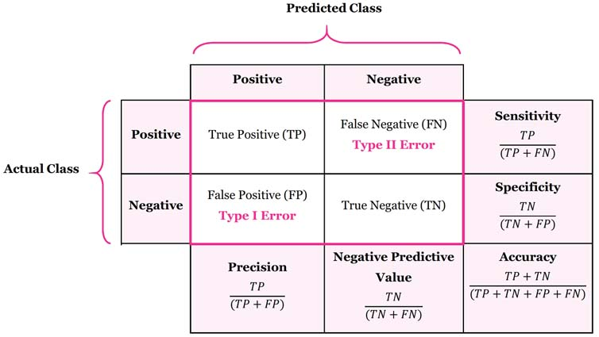
Confusion Matrix
Precision: What proportion of positive identifications was actually correct?
Recall: What proportion of actual positives was identified correctly?
F1 Score: Shows the harmonic mean of Precision and Recall values

Slide 19
Classification Threshold
Threshold value and its use in classification is used to strike a balance between precision and recall by specifying a value to determine our correct guesses and incorrect guesses.
To fully evaluate the effectiveness of a model, it is necessary to examine Precision and Recall
Precision and Recall are negatively correlated to each other.

Slide 20
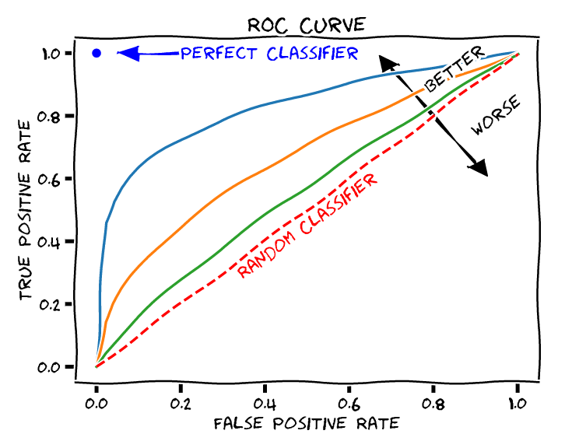
ROC and AUC
The AUC - ROC curve is a performance measure for the classification problem at various threshold values.
ROC is a probability curve. AUC represents the degree or measure of separability. It tells how(well) the model can distinguish the classes. The higher the AUC, the better the model is at predicting 0s as 0 and 1s as 1.

Slide 21
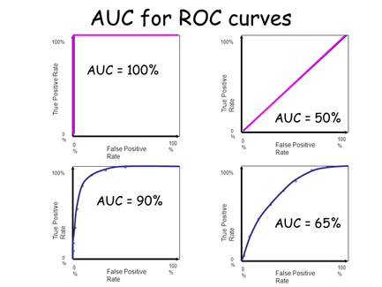
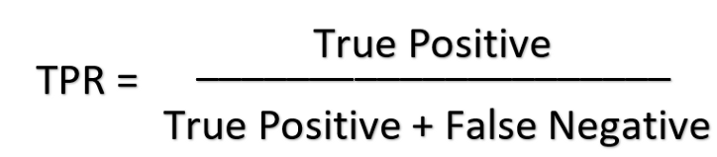
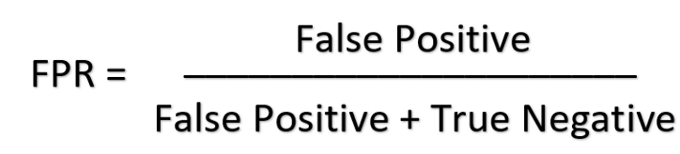
ROC and AUC
ROC is a probability curve for different classes. A typical ROC curve has False Positive Rate (FPR) on the X-axis and True Positive Rate (TPR) on the Y-axis.
One of the most widely used measures today is the AUC - ROC curve.
AUC stands for “Area under the ROC Curve”. The larger the area covered, the better the machine learning models are at doing the classification.
The ideal value for AUC is 1.

Slide 22
Commonly Used Classification Algorithms

Slide 23
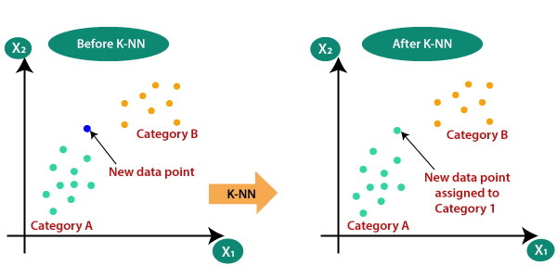
K-Nearest Neighbors
It is a supervised learning algorithm with a non-parametric structure, which is considered a lazy classifier.
Technically, it does not perform training to make predictions on a model. Predicts that an observation belongs to the class with the largest ratio by looking at its nearest neighbors.
It is used by making use of the distribution of the data in a sample cluster with certain classes. To estimate the class of a new data point, the distance of that point to the existing data points is calculated and its k number close neighbors are checked.

Slide 24
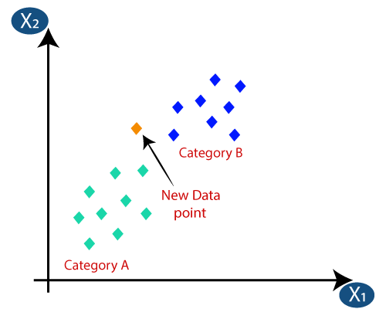
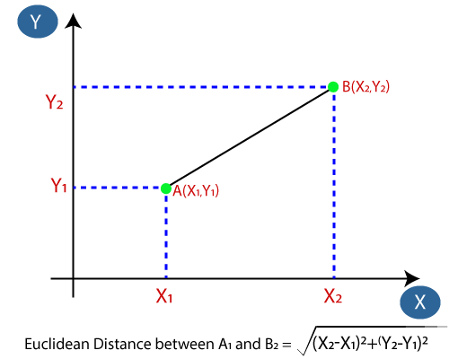
K-Nearest Neighbors
Let's say we have a new data point and we need to put it in the required category.
First, by choosing the number of neighbors, the number k is determined.
Euclidean distance between data is determined

Slide 25
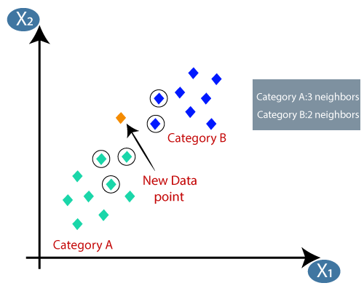
K-Nearest Neighbors
By calculating the Euclidean distance, we get the nearest neighbors as three nearest neighbors in category A and two nearest neighbors in category B.
The 3 closest neighbors are in category A, so this new data point must belong to category A.

Slide 26
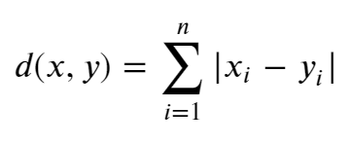
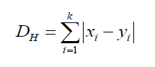
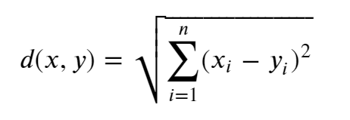
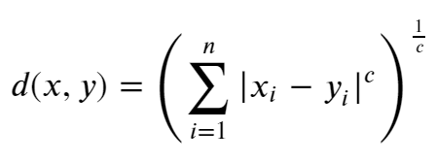
K-Nearest Neighbors
Distance Measurements
Depending on the context of the problem, different distance measures may be used.
The Minkowski method is used if it is desired to calculate the Minkowski distance, a distance dependent on the variable C.
When C = 1 the formula gives the Manhattan distance
When C = 2, it gives the Euclidean distance
The Hamming distance gives the similarity between two binary strings.
Manhattan distance
Hamming distance
Euclidean distance
Minkowski distance

Slide 27
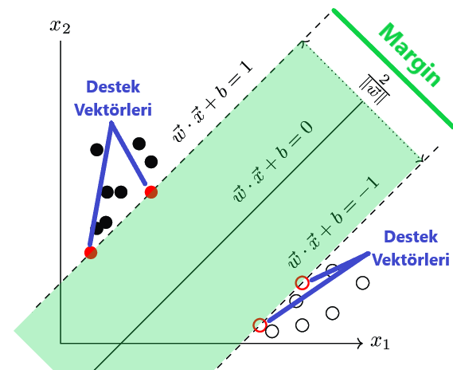
Support Vector Machine
It is one of the supervised learning methods generally used in classification problems.
A line is drawn to separate points placed on a plane.
This line is aimed to be at the maximum distance for the points of both classes.
It is suitable for complex but small and medium datasets. Solves Binary Classification problems

Slide 28
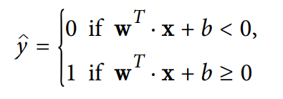
Support Vector Machine
It is a nonparametric classifier.
SVM can also classify linear and non-linear data, but is often used to classify linear data
The goal is to find the hyperplane that will allow the separation between the two classes to be optimal
This algorithm was originally created for classification problems. It was later adapted to regression problems
Notes:
Madde 2 -.???

Slide 29
What If Our Data Is Not Linearly Separated?

Slide 30
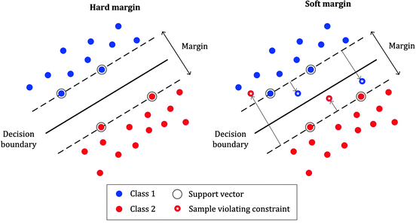
Hard Margin and Soft Margin
The width at which the limit can be increased before the margin reaches a data point. Margin is calculated as the perpendicular distance from the line to the nearest points only
Hard Margin works if our data is linearly separable and is very sensitive to outliers
Soft Margin is the case when the data is messy and cannot be perfectly separated by a hyperplane, the restriction to maximize the margin of the line separating the Classes is relaxed, allowing the data to violate the line
We can control the balance between the two with the hyper-parameter “C”

Slide 31
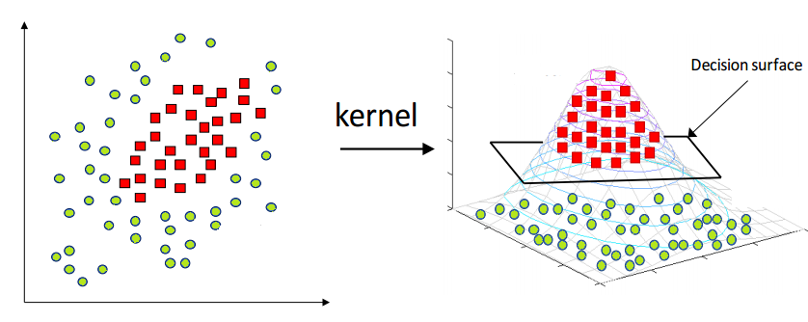
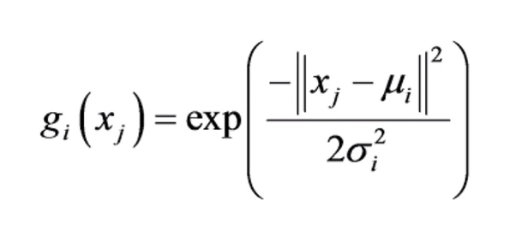
SVM Kernel Trick
SVM tries to classify data linearly. This is not possible in cases where our data is not linearly distributed. In such a case, Kernel Trick is used.
What can we do?
Provide linear classification by creating a new dimension
To classify linearly, the center point is determined and the closest values are stays above, the far ones are stays below.
iki boyutlu grafik kernel trick ile 3 boyutlu hale getirildi

Slide 32
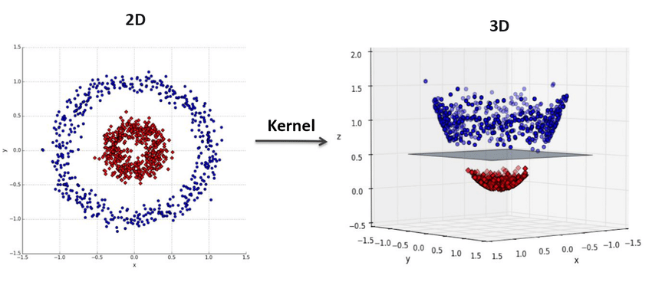
SVM Kernel Trick
To solve the Polynomial Kernel problem, it is necessary to act as if it is operating in 2, 3 or more dimensions. When using a line for a 2-dimensional distribution, a plane should be used when operating in a 3-dimensional space.
If the model is overfit , it will be necessary to lower its degree.
If it's underfit, it's necessary to raise its degree.

Slide 33
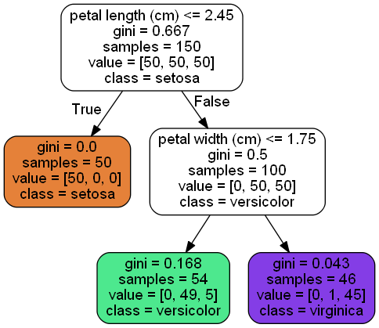
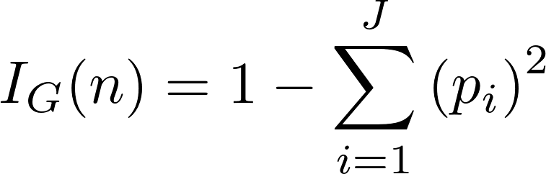
Decision Trees
It is one of the tree-based algorithms used in Classification and Regression problems
Can be used on complex datasets
The first cells of the decision trees are called the root (root or root node). Each observation is classified as “Yes” or “No” according to the root condition.
Root cells have nodes (interval nodes or nodes) underneath
Each observation is classified with the help of nodes. The complexity of the model increases as the number of nodes increases.

Slide 34
Colab Time !

